Slide 1

Do you know when your data is lying to you? The Hands On Workshop of Regression Analysis with Quantitative and Qualitative Variables
Dr. Steven C. Myers
Department of Economics, College of Business Administration
The University of Akron
Myers@uakron.edu
econdatascience.com
LinkedIn.com/in/stevencmyers
https://github.com/campnmug/Model_selection_and_inference
October 2019
Paper, slide deck, code and data
Code and data only

Slide 2
“Sinning in the basement: What are the rules? The Ten Commandments of Applied Econometrics.” by Peter E. Kennedy (2002)
Rule 1: | Use common sense and economic reasoning
Rule 2: | Avoid Type III errors
Rule 3: | Know the context
Rule 4: | Inspect the data
Rule 5: | Keep it sensibly simple
Rule 6: | Use the interocular trauma test
Rule 7: | Understand the costs and benefits of data mining.
Rule 8: | Be prepared to compromise
Rule 9: | Do not confuse statistical significance with meaningful magnitude
Rule 10: | Report a sensitive analysis

Slide 3
To begin: join me in creating the dataset Y.
What are we about?*
Articulate the problem.
Acquire, clean and transform the data.
Choose model specification and selection of variables
Do the analysis
Check the sensitivity of results to alternate models
DATA Y;
input Y @@;
datalines;
12.35 13.71 16.00 17.94 20.76 21.11 24.63
27.56 32.88 35.16 39.26 44.28 47.27 51.55;
run;
PROC means data=y mean std maxdec=4;
title 'The correct mean of y is 28.890 and the Std Dev is 12.9719';
run; title;

Slide 4
(1) read work.Y, (2) create, transform variables for testing, and (3) in this example only assume the data is clean.
Data work.trdata;
set work.Y;
T=_N_; /* 1. create time variable. */
TSQ = T*T; /* 2. and time-squared value. */
if T>=8 then D=1; Else D=0; /* 3. Create binary variable for the intervention. */
DT = D*T; /* 4. create interaction of D and T. */
run;

Slide 5
Business problem → Articulated Empirical Problem
Business problem:
What was the value of a policy change on our outcome metric?
Articulate the problem:
Question is:
Was the trend of our metric, Y, changed positively or negatively by our
measure of the policy/intervention, D?
H0: An intervention that begins in T=8 has no effect on the trend line.
H1: An intervention at T=8 changes the trend line.
Alternative problem:
The actual equation is nonlinear in variables and the intervention has no effect. That is, the natural nonlinear progression is why it may appear that the intervention D has an effect.

Slide 6
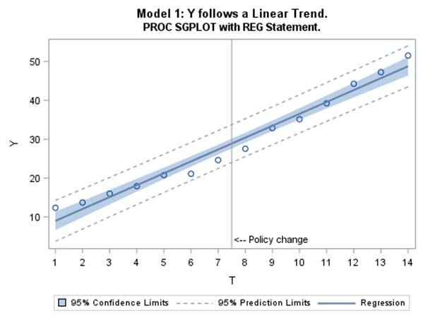
Visual method: Explore the trend of the metric Y
ods graphics on / noborder width=5in;
%let xref = %str( xaxis values=(1 to 14 by 1);
refline 7.5 / axis=x label="<-- Policy change"
labelloc=inside labelpos=min ;);
title1 'Model follows a Linear Trend.';
title2 'PROC SGPLOT with REG Statement.';
PROC SGPLOT data=trdata ;
reg x=T y=Y / CLM CLI ;
&xref;
run;
Visually, Y is trending upward, but there is a visible “U” or “V” shape in the residuals.

Slide 7
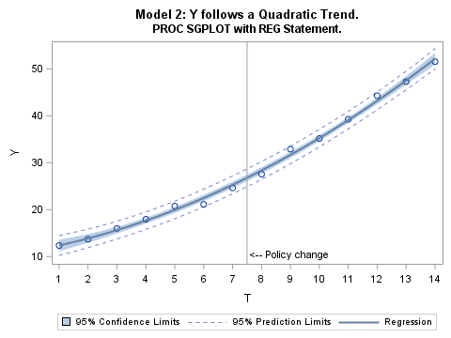
Visual method: Is Y a quadratic function of T?
title1 'Model 2: Y follows a Quadratic Trend.';
title2 'PROC SGPLOT with REG Statement.';
PROC SGPLOT data=trdata ;
reg x=T y=Y / degree=2 CLM CLI;
&xref;
run;
Visually Y does appear to follow a quadratic model such as
Y_{t} = β₀ + β₁T+ β₂T² + ε_{t}
And with very narrow Confidence Bands

Slide 8
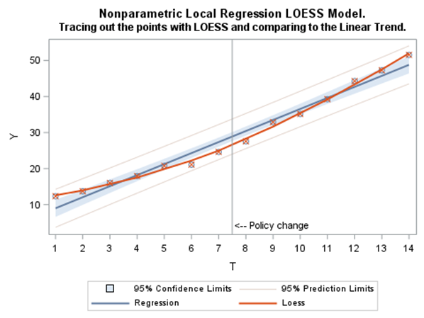
Visual method: What does a non-parametric trend reveal?
title1 'Nonparametric Local Regression LOESS Model.';
title2 'Tracing out the points with LOESS and comparing to the Linear Trend.';
PROC SGPLOT data=trData;
reg x=T y=Y / degree=1
CLM CLI CLMTRANSPARENCY=.5;
loess x=T y=Y /
interpolation=linear degree=2;
&xref;
run;
The loess regression appears to trace out a
clear “curve” such as a quadratic relationship.

Slide 9
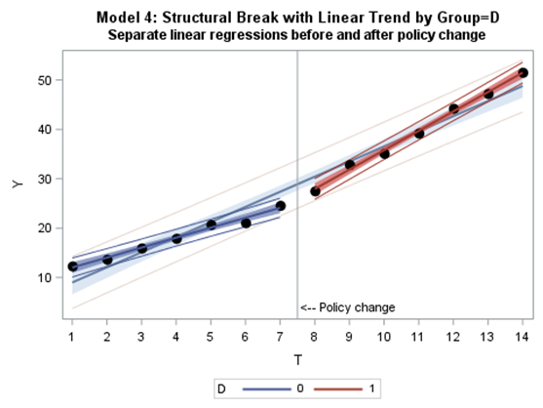
Visual method: linear regression by group (or time-slice)
title1 'Model 4: Structural Break with Linear Trend by Group=D';
title2 'Separate linear regressions before and after policy change';
PROC SGPLOT data=trdata;
reg x=T y=Y / CLM CLI CLMTRANSPARENCY=.5;
reg x=T y=Y / CLM CLI CLMTRANSPARENCY=.25 group=D
markerattrs=(symbol=circlefilled color=black size=10px);
&xref;
run;
Linear regressions in the first and second time-slice appear to be good representations of the observations, that is smaller residuals than in the first graph.

Slide 10
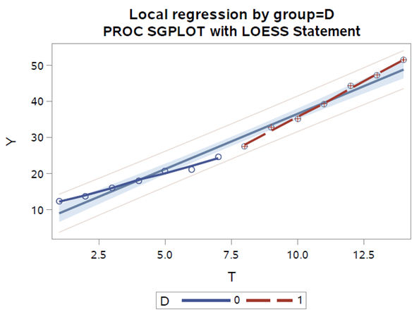
Visual method: nonparametric regression by group
title1 'Local regression by group=D';
title2 "PROC SGPLOT with LOESS Statement";
PROC SGPLOT data=trData;
reg x=T y=Y / CLM CLI CLMTRANSPARENCY=.5;
loess x=T y=Y / group=D
interpolation=linear degree=2;
run;
The nonparametric regression appears to trace out linear regressions in both time-slices, that is, the high curvature doesn’t seem to show.

Slide 11
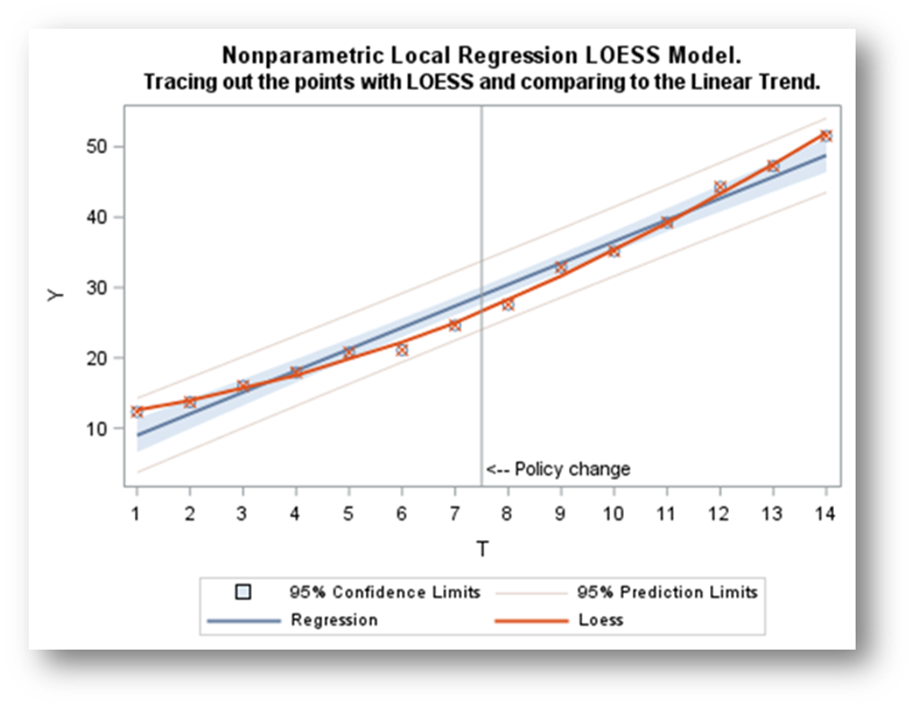

What have we learned?
Suggested model: $Y=β0+β1T+β2T2+ε$
Suggested model: $Y=β0+β1T+β2D+β3DT+ε$
Restricted model: $Y=β0+β1T+ε$

Slide 12
Let’s turn from a graphical to a statistical / econometric approach The viz are a type of EDA, for example looking for outliers, before we estimate our models After we run the regressions we should be looking at influential observations, examining residuals and appropriate statistics, but in this paper we will not cover that.

Slide 13
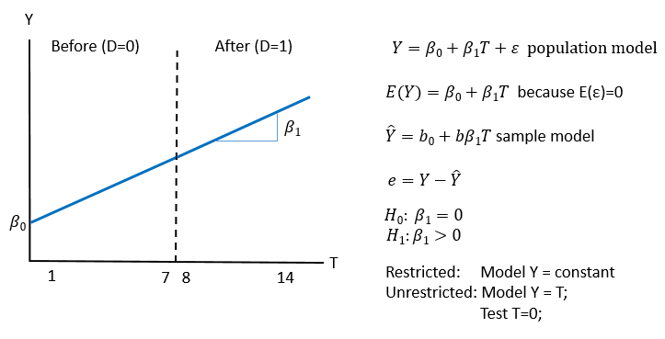
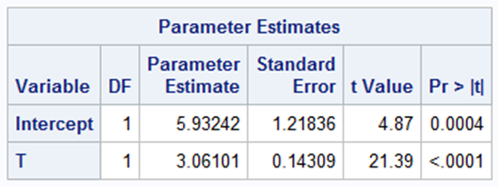
First regression: Establish the trend in the base model.
Adj R² = 0.972
ods graphics on;
Title1 'Regression Specifications - full sample' ;
PROC REG data=trdata;
var T TSQ D DT;
model_1: model Y = T;
run;

Slide 14
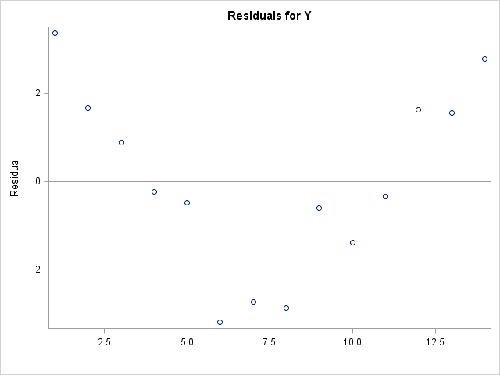
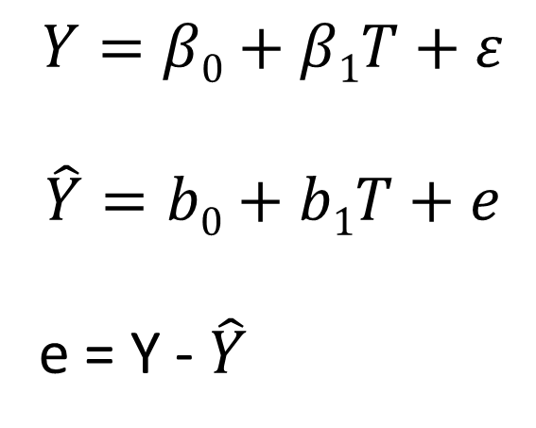
Look at the residuals in this simple regression $Y=β0+β1T+ε$
$$Y=β0+β1T+ε$$
$$\hat{Y}=b0+b1T+e$$
e = Y - $\hat{Y}$

Slide 15
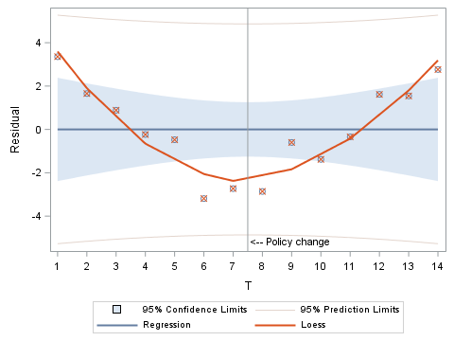
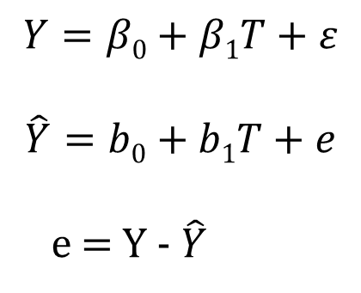
Look at the residuals in this simple regression
$$Y=β0+β1T+ε$$
$$\hat{Y}=b0+b1T+e$$
e = Y - $\hat{Y}$
Title2 'Examining the residuals to the linear trend model.';
PROC REG data=trdata;
model_1R: model Y = T;
output out=TR r=residual;
run;
PROC SGPLOT data=tr;
reg x=T y=residual / degree=1 CLM CLI CLMTRANSPARENCY=.5;
loess x=T y=residual / interpolation=linear degree=2;
&xref;
run;

Slide 16
Hasty Regression
“I was so excited to get our data, the first thing I wanted to do was run a regression,” a well published friend and careful data user said this to me recently in a voice that mixed both the excitement of new data and the tone of guilt because she knew it to be “wrong.”
Econometricians sometimes act like
“God gave us the model”
-- Susan Athey
Throwing a dummy variable in the model is not a sufficient test of the effect of that variable
-me

Slide 17
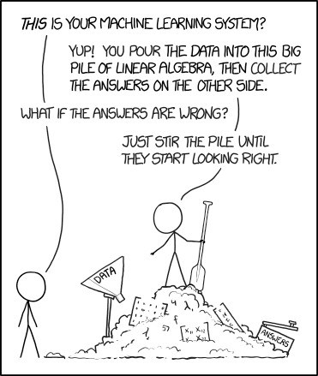
Why isn’t hasty regression enough?
Garbage in,
Garbage out.
If you torture the data long enough, it will confess.
-Ronald Coase
So why not use automatic model selection?
Regression selection process | winning model
Selection=adjRsq | T D DT
Selection=Stepwise | T TSQ
Selection=Forward | T TSQ D DT
Selection=Backward | T D DT
Selection=maxR | T TSQ D DT
Selection=minR | T TSQ D DT
Selection=CP | T D DT
How about use some thought?
Economics and common sense
Know the DGP and context
Clean the data before
Inspect the data after
Validate your specification and testing.
https://xkcd.com/1838/

Slide 18
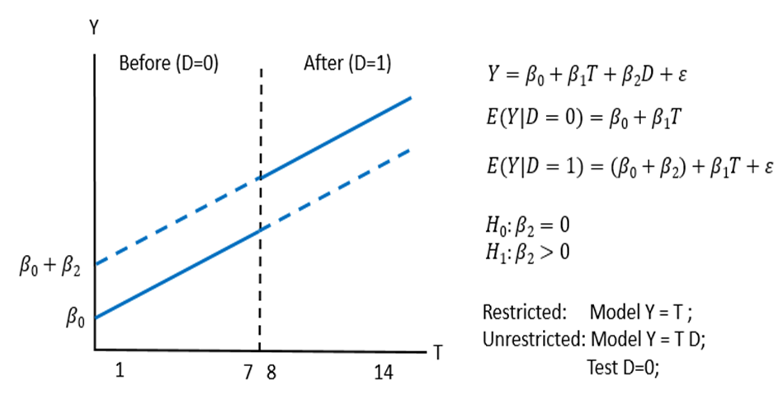
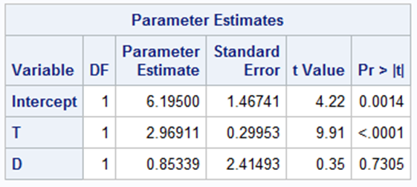
Hasty Regression: Just throw in a dummy variable.
Adj R² = 0.970 < .972 for linear model_1
The intervention apparently
does not affect the outcome.
Y = 5.9 + 3.1T + e₁
Y = 6.2 + 3.0T + 0.9D + e₂
title2 'Just throw in a dummy variable';
model_3: model y = t d;
run;
This is the data lie in this paper
D is not significant
in this specification.

Slide 19
Lack of Proof, its all about rejection
H₀: β₂=0 The intervention had no effect
H₁: β₂≠0 The intervention had an effect
This requires a testing strategy which will require multiple
Well thought specifications and test statements
The statistician’s decision | H₀ is true | H₀ is false
Rejects H₀ | α = P(reject H₀|H₀ is true) A wrong decision Convicting the innocent Type I Error | 1-β = P(reject H₀|H₀ is false) A correct decision Convicting the guilty Power of the test
Fails to Reject H₀ | 1-α = P(fail to reject H₀|H₀ is true) A correct decision Letting the innocent go free Confidence in the test | β = P(fail to reject H₀|H₀ is false) A wrong decision Letting the guilty go free Type II Error

Slide 20
Lack of Proof, its all about rejection
H₀: β₂=0 The intervention had no effect
H₁: β₂≠0 The intervention had an effect
The problem with this is it is sensitive to model specification
The statistician’s decision | H₀ is true | H₀ is false
Rejects H₀ | α = P(reject H₀|H₀ is true) A wrong decision Convicting the innocent Type I Error | 1-β = P(reject H₀|H₀ is false) A correct decision Convicting the guilty Power of the test
Fails to Reject H₀ | 1-α = P(fail to reject H₀|H₀ is true) A correct decision Letting the innocent go free Confidence in the test | Β = P(fail to reject H₀|H₀ is false) A wrong decision Letting the guilty go free Type II Error
Avoid Type III errors which occurs when you get the right answer to the wrong question (Kennedy, 2008).
Far better an approximate answer to the right question than an exact answer to the wrong question, which can always be made precise. (Tukey, 1962)
… the initial problem has been transformed to a different question (Maddala, 1999)

Slide 21
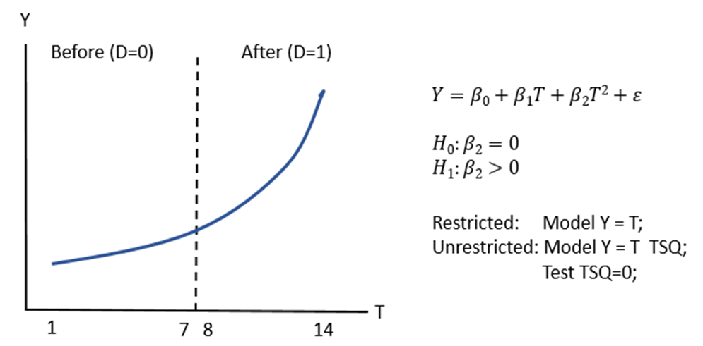
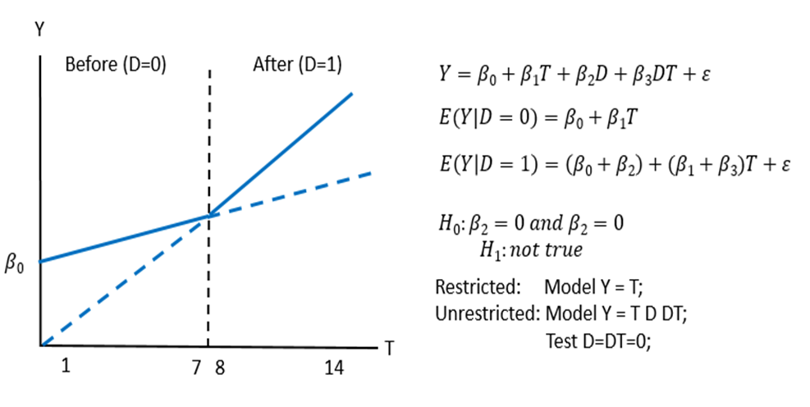
Two models suggested by the visual analysis
title2 'Quadratic Model';
model_2: model Y = T TSQ;
Quadratic: test tsq=0;
run;
 | F Value | P-value | adjR² | Root MSE
Quadratic: test tsq=0; | 76.84 | <.0001 | 0.996 | 0.80
Structural_break: test D=DT=0; | 61.32 | <.0001 | 0.998 | 0.65
title2 'Structural break model';
model_4: model Y = T D DT;
Structural_break: test D=DT=0;
run;

Slide 22
Both models perform very well.
These are called nested hypothesis. The null hypothesis
Is a subset of the model being tested.
Model 1 is the restricted model compared to the unrestricted models 2 and 4.
Both models 2 and 4 reject the null hypothesis of a linear trend.
Both the quadratic model and structural break model are “acceptable.”
 | Sample defined as years 1 to 14
 | (1) |  | (2) |  | (3) |  | (4)
constant | 5.93 | *** | 11.12 | *** | 6.2 | *** | 10.01 | ***
 | (4.87) |  | (14.96) |  | (4.22) |  | (18.25)
T | 3.06 | *** | 1.12 | *** | 2.97 | *** | 2.01 | ***
 | (21.39) |  | (4.9) |  | (9.91) |  | (16.42)
TSQ |  |  | 0.13 | ***
 |  |  | (8.77)
D |  |  |  |  | 0.85 |  | -13.47 | ***
 |  |  |  |  | (0.35) |  | (-9.12)
DT |  |  |  |  |  |  | 1.91 | ***
 |  |  |  |  |  |  | (11.01)
n | 14 |  | 14 |  | 14 |  | 14
adj R sq | 0.972 |  | 0.996 |  | 0.970 |  | 0.998
F | 457.6 |  | 1713.4 |  | 212.2 |  | 1717.1
root MSE | 2.16 |  | 0.80 |  | 2.24 |  | 0.65
note: All regressions estimated with OLS using the SAS REG procedure. t-stats in parentheses. *** significant at the .01 level ** significant at the .05 level * significant at the .10 level
 | F Value | P-value
Quadratic: test tsq=0; | 76.84 | <.0001
Structural_break: test D=DT=0; | 61.32 | <.0001

Slide 23
How do the models fit in the before and after period?
If the quadratic model ruled, then it would exist in the sub samples and it does not!
There was a structural break!
title2 ‘Before Sample, T=1,...,7';
PROC reg data=work.trdata;
model_5: model Y = T ;
model_6: model Y = T TSQ ;
where D=0;
run;
title2 ‘After Sample, T=8,..., 14';
PROC reg data=work.trdata;
model_7: model Y = T ;
model_8: model Y = T TSQ ;
where D=1;
run;
 | Sample year 1 to 7 |  |  |  | Sample year 8 to 14
 | (5) |  | (6) |  | (7) |  | (8)
constant | 10.01 | *** | 10.42 | *** | -3.45 | ** | -3.19
 | (17.13) |  | (9.87) |  | (-2.42) |  | (-0.03)
T | 2.01 | *** | 1.74 | ** | 3.92 | *** | 3.87 | **
 | (19.04) |  | (2.88) |  | (30.76) |  | (2.13)
TSQ |  |  | 0.034 |  |  |  | 0.002
 |  |  | (0.46) |  |  |  | (0.03)
n | 7 |  | 7 |  | 7 |  | 7
adj R sq | 0.980 |  | 0.976 |  | 0.994 |  | 0.992
F | 293.5 |  | 123.7 |  | 946.1 |  | 378.5
root MSE | 0.62 |  | 0.68 |  | 0.68 |  | 0.75
note: All regressions estimated with OLS using the SAS REG procedure. t-stats in parentheses. *** significant at the .01 level ** significant at the .05 level * significant at the .10 level

Slide 24
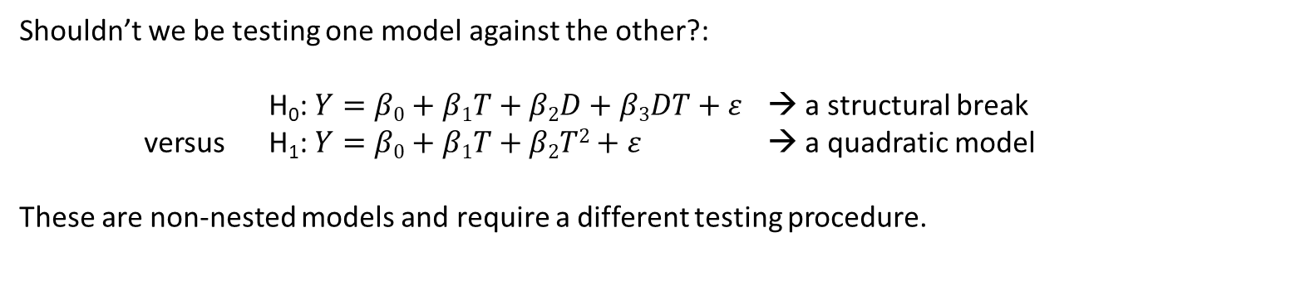
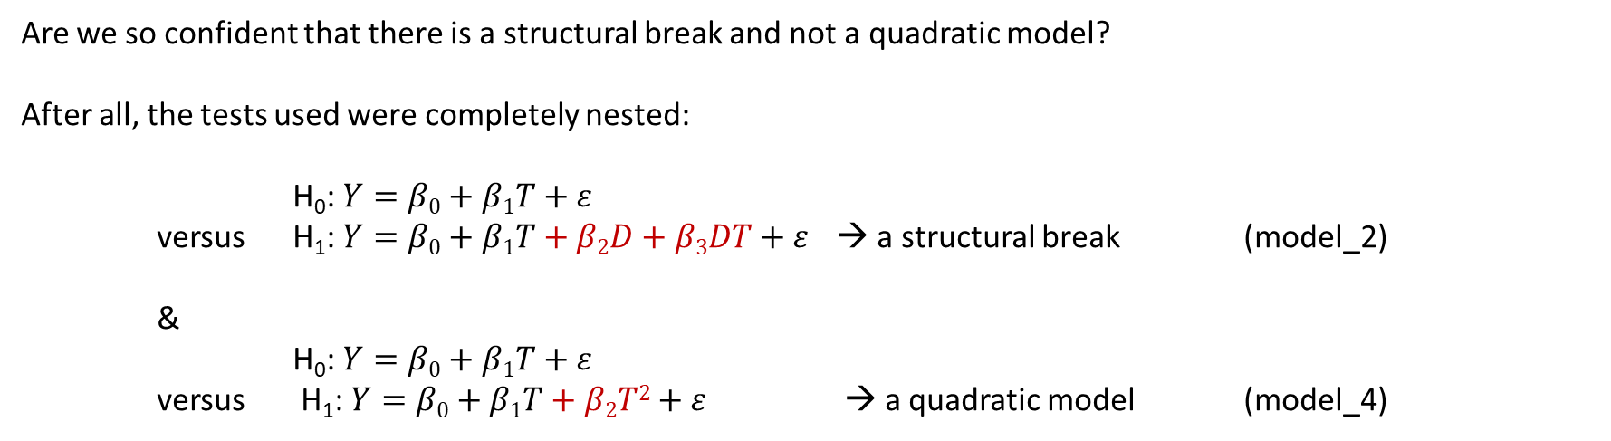
Non-nested hypothesis testing
Are we so confident that there is a structural break and not a quadratic model?
After all, the tests used were completely nested:
H₀: $Y=β0+β1T+ε$
versus H₁: $Y=β0+β1T+β2D+β3DT+ε$ → a structural break (model_2)
&
H₀: $Y=β0+β1T+ε$
versus H₁: $Y=β0+β1T+β2T2+ε$ → a quadratic model (model_4)
Shouldn’t we be testing one model against the other?:
H₀: $Y=β0+β1T+β2D+β3DT+ε$ → a structural break
versus H₁: $Y=β0+β1T+β2T2+ε$ → a quadratic model
These are non-nested models and require a different testing procedure.

Slide 25
Non-nested hypothesis testing
Title1 'Non-nested hypothesis - J-test';
Proc reg data=trdata;
model_2: model Y = T TSQ;
output out=Mquad p=Yquadhat;
run;
Proc reg data=trdata;
model_4: model Y = T D DT;
output out=Mbreak p=Ybreakhat;
run;
Proc reg data=Mbreak;
model_2A: model Y = T TSQ Ybreakhat;
run;
Proc reg data=Mquad;
model_4A: model Y = T D DT Yquadhat;
run;
Title1 'Non-nested hypothesis test - super model, F-test';
Proc reg data=trdata;
model_4A: model Y = T TSQ D DT;
quad: test TSQ = 0;
structural_break: test D=DT=0;
run;

Slide 26
Four tests all reject ‘quadratic’ in favor of the ‘structural break’ model.
 | Variance encompassing test |  |  |  |  |  |  |  |  |  | Mean encompassing test
 | Quadratic |  | J-TEST |  | Break |  | J-TEST |  |  |  |  | F-TEST
constant | 11.12 | *** | 1.26 |  | 10.01 | *** | 8.67 | *** |  |  |  | 10.23 | ***
 | (14.96) |  | (-0.33) |  | (18.25) |  | (2.22) |  |  |  |  | (12.01)
T | 1.12 | *** | 0.11 |  | 2.01 | *** | 1.71 | *** |  |  |  | 1.87 | ***
 | (4.9) |  | (0.25) |  | (16.42) |  | (1.94) |  |  |  |  | (4.26)
TSQ | 0.13 | *** | 0.02 |  |  |  |  |  |  |  |  | 0.02
 | (8.77) |  | (0.33) |  |  |  |  |  |  |  |  | (0.35)
D |  |  |  |  | -13.47 | *** | -11.56 | *** |  |  |  | -11.56 | **
 |  |  |  |  | (-9.12) |  | (-2.02) |  |  |  |  | (-2.02)
DT |  |  |  |  | 1.91 | *** | 1.66 | *** |  |  |  | 1.66
 |  |  |  |  | (11.01) |  | (2.19) |  |  |  |  | (2.19)
Y-prediction |  |  | 0.89 | ** |  |  | 0.14 |  |  |  | quad: test TSQ = 0; | F = 0.12
from other model |  |  | (2.61) |  |  |  | (0.35) |  |  |  | break: test D=DT=0; | F = 3.07 | *
n | 14 |  | 14 |  | 14 |  | 14 |  |  |  |  | 14
adj R-sq | 0.972 |  | 0.998 |  | 0.970 |  | 0.997 |  |  |  |  | 0.997
F | 457.6 |  | 1746.3 |  | 212.2 |  | 1181.4 |  |  |  |  | 1181.4
root MSE | 2.16 |  | 0.06 |  | 2.24 |  | 0.68 |  |  |  |  | 0.68
note: All regressions estimated with OLS using the SAS REG procedure.
T-stats in parentheses.
*** significant at the .01 level
** significant at the .05 level
* significant at the .10 level
Parameters unique to the ‘quadratic’ model are not rejected from zero.
Conclusion: the ‘break’ model is not rejected.
The ‘break’ model contributes significantly to the explanation of the ‘quadratic’ model.
Conclusion: reject the ‘quadratic’ model
The ‘quadratic’ model contributes nothing to the explanation of the ‘break model.
Conclusion: fail to reject the ‘’break’ model
Parameters unique to the ‘break’ model are rejected from zero.
Conclusion: the ‘quadratic’ model is rejected.

Slide 27
J-test |  | F-test
Quadratic Model | Structural Break | Quadratic Model | Structural Break
“Acceptable” | “Acceptable” | “Acceptable” | “Acceptable”
 |  | “Acceptable” | “not Acceptable”
 |  | “not Acceptable” | “Acceptable”
 |  | “not Acceptable” | “not Acceptable”
“Acceptable” | “not Acceptable” | “Acceptable” | “Acceptable”
 |  | “Acceptable” | “not Acceptable”
 |  | “not Acceptable” | “Acceptable”
 |  | “not Acceptable” | “not Acceptable”
“not Acceptable” | “Acceptable” | “Acceptable” | “Acceptable”
 |  | “Acceptable” | “not Acceptable”
 |  | “not Acceptable” | “Acceptable”
 |  | “not Acceptable” | “not Acceptable”
“not Acceptable” | “not Acceptable” | “Acceptable” | “Acceptable”
 |  | “Acceptable” | “not Acceptable”
 |  | “not Acceptable” | “Acceptable”
 |  | “not Acceptable” | “not Acceptable”
Complete encompassing reconciliation of the
Mean Encompassing tests (J-test)
and the
Variance Encompassing Tests (F-test)

Slide 28
Use of automatic model selection in PROC REG
Regression selection process | winning model
Selection=adjRsq | T D DT
Selection=Stepwise | T TSQ
Selection=Forward | T TSQ D DT
Selection=Backward | T D DT
Selection=maxR | T TSQ D DT
Selection=minR | T TSQ D DT
Selection=CP | T D DT
Automatic selection leads to the
Structural break model 3 times
Quadratic model 1 time, and the
Super model 3 times.
Which to believe?

Slide 29
Ramsey misspecification tests (RESET) from SAS/ETS
Model | P=2 | P=3 | P=4
1 Y=T Linear | Reject | Reject | Reject
2 Y=T TSQ Quadratic | Fail to reject | Fail to reject | Fail to reject
3 Y=T D Hasty | Reject | Reject | Reject
4 Y=T D DT Structural break | Fail to reject | Fail to reject | Fail to reject
proc autoreg data=trdata;
model_1: model y = T / reset;
run;
proc autoreg data=trdata;
model_2: model y = T TSQ/ reset;
run;
proc autoreg data=trdata;
model_3: model y = T D / reset;
run;
proc autoreg data=trdata;
model_4: model y = T D DT/ reset ;
run;

Slide 30
Conclusion: There is strong evidence of a structural break in the metric Y because of the intervention, D, as studied.
Visually, we liked two models on the entire sample and only the linear on the sub-samples.
We showed that a Hasty Regression led to a false conclusion, namely that D did not matter. This was the biggest lie in the data. [Not only did D have no effect in Model Y = T D; it also has no effect in Model Y = T TSQ D; either. Hasty regression lies whether you assume a base linear or nonlinear model in time. ]
Eight regressions were necessary to complete a testing strategy that convinced us that the structural break model was a better representation of the data.
A Ramsey test for misspecification was run on all models and found the structural break and quadratic models both “acceptable.”
The ‘quadratic model’ was tested against the ‘structural break’ model directly by the use of non-nested hypotheses: four tests were run and in each case the ‘quadratic model’ was found lacking.
Finally, automatic processes do not arrive at the same conclusion. Human critical thinking processes are critical for making sense of this data.

Slide 31
Thank You! NOW you know when your data is lying to you! The Hands On Workshop of Regression Analysis with Quantitative and Qualitative Variables
Dr. Steven C. Myers
Department of Economics, College of Business Administration
The University of Akron
Myers@uakron.edu
econdatascience.com
LinkedIn.com/in/stevencmyers
https://github.com/campnmug/Model_selection_and_inference
October 2019
Paper, slide deck, code and data

